Slide 1

PMA: Week-1 Introduction to Project Management; Introduction to Agile; Team Formation & Collaboration Dr. Bhuvan UNHELKAR Professor of Information Technology www.Unhelkar.com; Office: C225; bunhelkar@sar.usf.edu; 941-359-4654

Slide 2
Agenda
The What and Why of Project Management
Project Management
Frameworks and Lifecycles
Introducing Agile
Project Team Formation
Summary & Consolidation

Slide 3

Project Management Institute: PMI® Intellectual Property Acknowledgement
The PMI Registered Education Provider Logo is a registered mark of the Project Management Institute, Inc.
This material is currently used ONLY for academic purposes;
MethodScience earlier used this when it was a Registered Education Provider (R.E.P.) of the PMI
Some Diagrams and Materials have used the Project Management Institute’s, A Guide to the Project Management Body of Knowledge (PMBOK® Guide) – Fifth Edition
Project Management Institute, Inc., 2008
PMBOK is a registered trademark of the Project Management Institute, Inc.

Slide 4
Sub-Module Why do we Need Project Management?
Some Statistics and a Reasoning for the need for formal PM
© MethodScience; Material Designed and Presented by Dr. B. Unhelkar

Slide 5
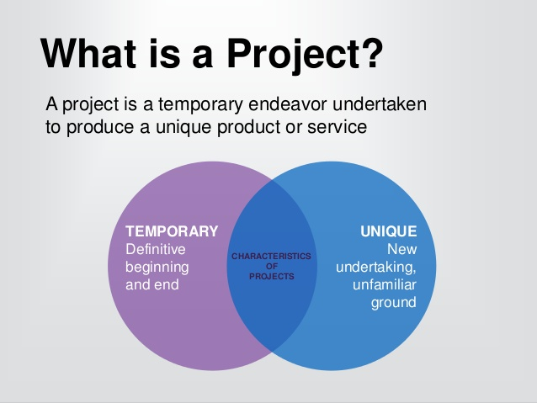
What is a Project?
A set of Activities
Has a Start and an End Date
Has a goal/objective to achieve
Activities are broken down into Tasks
Each Task is assigned a Time and Cost

Slide 6
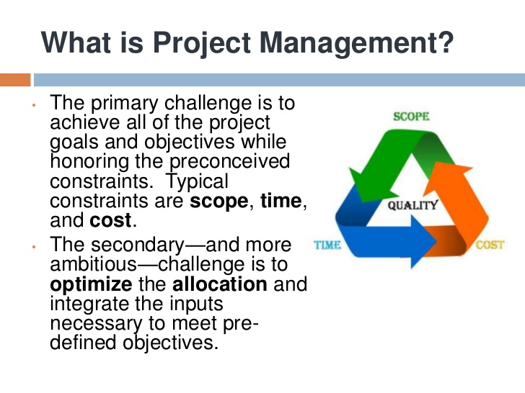

Slide 7
Half the projects are late, over budget and don’t deliver the functionality they promise (Chaos Report)
There does appear to be any major improvement in project performance since 2002

Slide 8
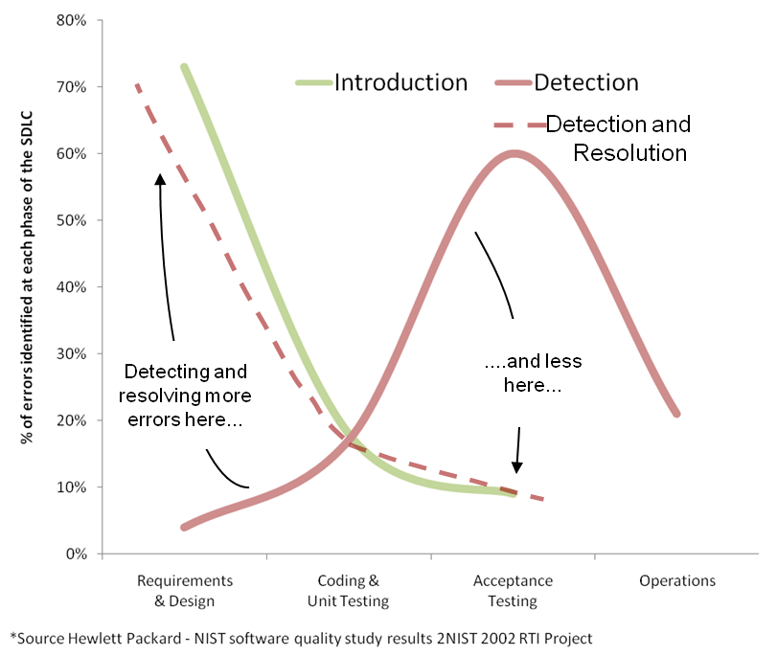
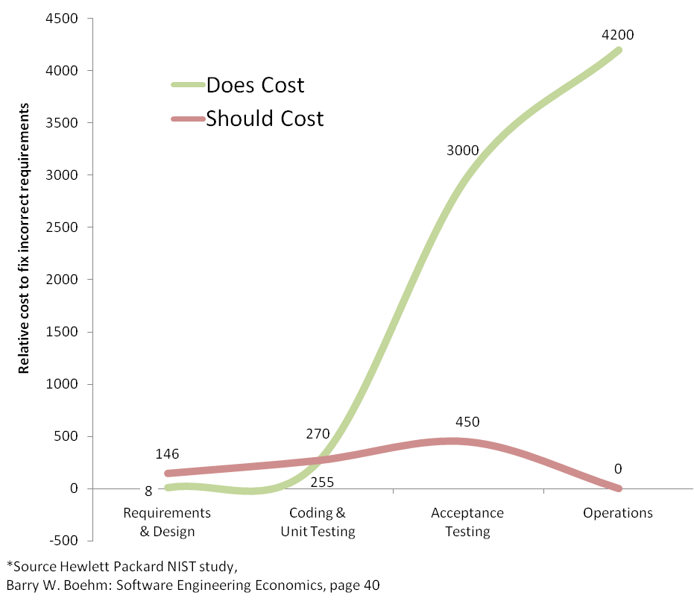
Errors and their Impact on Projects!
Sooner the Requirements are modelled and Analysed, better are the chances of improving project performance (more than 8 times!!)
Total Relative Cost
Does Cost | 7463
Should Cost | 866
Difference % | 862%

Slide 9
A Short Exercise (Discussion on Project Management)
What is a Project?
__________________________________
Why should we “manage” a Project?
__________________________________
What are the advantages of tightly managing a Project?
__________________________________
What are the challenges when a Project is tightly controlled?
__________________________________

Slide 10
Sub-Module Software (Development) Project Management Lifecycles
As Basis for Project Management Discipline and Frameworks
© MethodScience; Material Designed and Presented by Dr. B. Unhelkar

Slide 11
Figure 2.11: Overview of Project Lifecycles (also known as SDLC – Software Development Life Cycles)
Waterfall
Spiral
Iterative
Fountain
Iterative
Incremental
Incremental
Planning Focus (Large
Projects)
Activity Focus (Small Projects)
CMM-I
Maturity Primarily Applies here
Iterative – Incremental – Parallel
Agile
Agile
Agile
Agile
Agile
Agile
Practice Based

Slide 12
Waterfall model
Requirements
Analysis
Design
Implementation
Test
Maintenance

Slide 13
Waterfall model
Linear – PLANNED – approach to developing Software
From one phase to the next in a purely sequential manner
Design begins when and only when the requirements are fully completed
For simple systems – or systems with simple process for development
Not realistic for complex systems whose requirements are likely to CHANGE

Slide 14
CUMULATIVE
COST
PROGRESS
THROUGH
DETERMINE
STEPS
OBJECTIVES,
EVALUATE ALTERNATIVES.
ALTERNATIVES,
IDENTIFY, RESOLVE RISKS
CONSTRAINTS
RISK ANALYSIS
RISK ANALYSIS
RISK
ANALYSIS
R
PROTO
OPERATIONAL
PROTO
A
TYPE
PROTOTYPE
PROTOTYPE
TYPE
COMMITMENT
REVIEW
1
2
3
PARTITION
RQTS PLAN
CONCEPT
SIMULATIONS
MODELS
LIFECYCLE
OF
BENCHMARKS
PLAN
OPERATION
SOFTWARE
RQTS
DEVELOPMENT
DETAILED
PLAN
RQTS
SOFTWARE
DESIGN
VALIDATION
PRODUCT
INTEGRATION
DESIGN
AND TEST
DESIGN VALIDATION
UNIT
CODE
AND VERIFICATION
TEST
INTEGRATION
AND TEST
PLAN
ACCEPTANCE
NEXT PHASES
TEST
DEVELOP, VERIFY
IMPLEMENT-
NEXT-LEVEL
ATION
PRODUCT
(after Boehm, 1986, 1988; Boehm and Belz, 1988)

Slide 15
Spiral model
Top left quadrant (quadrant 1) : determine objectives of that phase, alternatives and constraints
Quadrant 2: identify and resolve risks
Quadrant 3: development and test
Finally (quadrant 4): plan the next iteration

Slide 16
Iterations and increments
Itr 1
Itr 1
Itr 2
Itr 2
Itr 3
Itr 3
Increment 1
(Patient Package)
Increment 2
(Consulting Package)

Slide 17
Typical Time and effort per iteration in an Iterative, Incremental, Parallel process
The first iteration is rapid. It ensures that all participants get a feel for the project; it enables formal cost estimation (first attempt), project planning, and “Go/No Go” decision. Increments may also be decided in this iteration. Deliverables in this iteration relate to MOPS, and information from background space influences it.
15%
Initial
This is the major iteration of the project; in large projects, this would be the major iteration in an increment. Most process-components are worked through in this iteration. Because of extensive work in the solution space, this iteration results in major component-based development. MOSS and corresponding implementation process-components are applied.
60%
Major
While polishing off the work completed in the major iteration, this iteration focuses on pilot testing and system launch.
25%
Final
Not an iteration in the normal sense. Domain-related activities and maintenance of the released system are ongoing activities here.
Ongoing

Slide 18
Short Exercise
Describe a key difference between the Waterfall and Spiral SDLC : ______________________________________________________________________________________
What is an Iteration? How does it differ from an Increment? : ______________________________________________________________________________________

Slide 19

Sub-Module Popular Project Management Frameworks
SFIA
PRINCE2
PMBOK
© MethodScience; Material Designed and Presented by Dr. B. Unhelkar

Slide 20
Project Management Frameworks
PMBOK (PMI)
SFIA
Agile-Group
Prince2
CAMS
(Composite Agile
Methods & Strategy)
Apply Formality to PM Skills

Slide 21
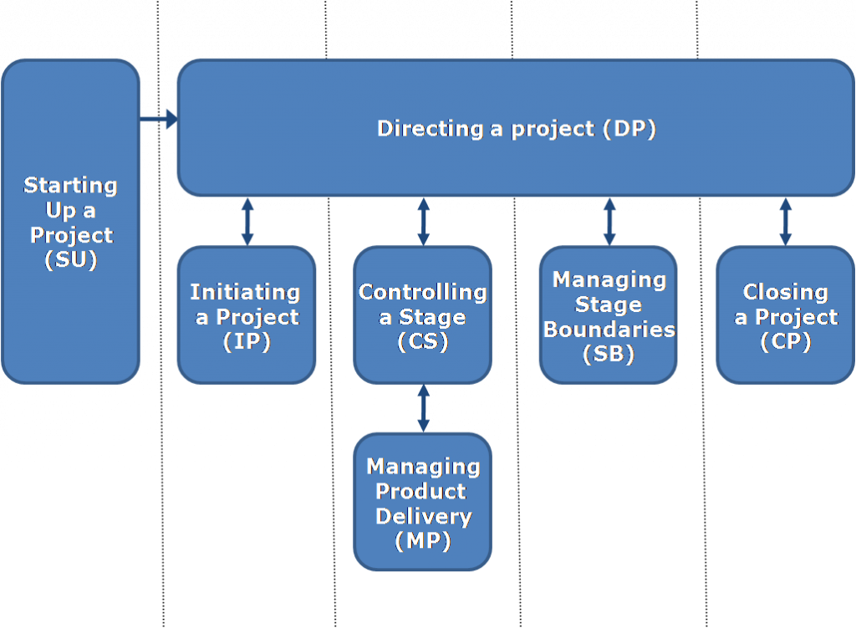
PRojects In Controlled Environments – Prince2

Slide 22
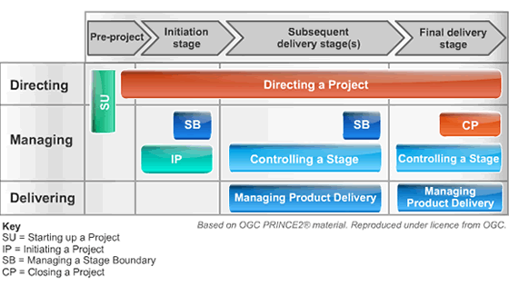
PRojects In Controlled Environments – www.Prince2.com

Slide 23
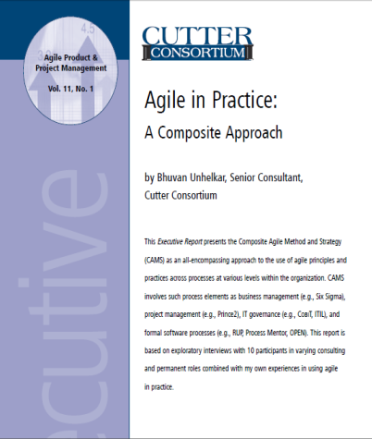
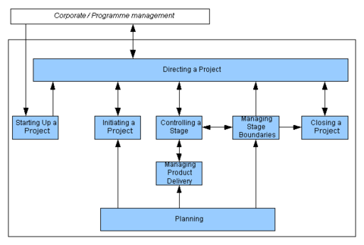
Alternative View: Major Phases of Prince2 – Review Page 12 of Agile In Practice
Starting Up a Project
Directing a Project
Initiating a Project
Controlling a Stage
Managing Product Delivery
Managing a Stage Boundary
Closing a Project
Each of the Prince 2 Phases have a Agile impact – as discussed in the Report
Notes:
Prince-2 & PMBOK® good for Large Sized Projects. Size v/s Integration
Smaller sized Projects are easier to Manage
Large Projects are broken down into Smaller Projects for Management
This leads to need for Integration towards the end of multiple projects
Integration challenges need to be balanced with Size

Slide 24
The SFIA-Based Project Management Framework
Information management IRMG
Information assurance INAS
Consultancy CNSL
Software development process improvement SPIM
Methods and tools METL
Portfolio management POMG
Programme management PGMG
Project management PRMG
Portfolio, programme and project support PROF
Resourcing RESC
Programming/software development PROG
IT management ITMG
Capacity management CPMG
Availability management AVMT
Service level management SLMO
Service acceptance SEAC
Change management CHMG
Release and deployment RELM
Applications support ASUP
Database administration DBAD
IT estate management DCMA
Procurement PROC
Supplier relationship management SURE
Contract management ITCM
Core PM Skill Set (24 out of Total 96 SFIA Skill Sets)
7. Strategize; Inspire
6. Initiate, Influence
5. Ensure, Advise
4. Enable
3. Apply
2. Assist
1. Follow
Autonomy
Influence
Complexity
Supervision Level
Immediate, Organizational, Global
Routine versus Unexpected
Business Skills
Application
7 SFIA Levels
Defining each Level (x 4)
Notes:
Autonomy: Works under broad direction. Is fully accountable for own technical work and/or project/supervisory responsibilities. Receives assignments in the form of objectives. Establishes own milestones and team objectives, and delegates responsibilities. Work is often self-initiated.
Influence: Influences organisation, customers, suppliers and peers within industry on the contribution of own specialism. Has significant responsibility for the work of others and for the allocation of resources. Makes decisions which impact on the success of assigned projects i.e. results, deadlines and budget. Develops business relationships with customers.
Complexity: Performs a challenging range and variety of complex technical or professional work activities. Undertakes work which requires the application of fundamental principles in a wide and often unpredictable range of contexts. Understands the relationship between own specialism and wider customer/organisational requirements.
Business skills: Advises on the available standards, methods, tools and applications relevant to own specialism and can make correct choices from alternatives. Analyses, diagnoses, designs, plans, executes and evaluates work to time, cost and quality targets. Communicates effectively, formally and informally, with colleagues, subordinates and customers. Demonstrates leadership. Facilitates collaboration between stakeholders who have diverse objectives. Understands the relevance of own area of responsibility/specialism to the employing organisation. Takes customer requirements into account when making proposals. Takes initiative to keep skills up to date. Mentors more junior colleagues. Maintains an awareness of developments in the industry. Analyses requirements and advises on scope and options for operational improvement. Demonstrates creativity and innovation in applying solutions for the benefit of the customer.
BPRe Level 5
BUAN Level 5
REQM Level 5
BENM Level 5
BSMO Level 5
UNAN Level 5
QUAS Level 5
BURM Level 4
RLMT L4
USEV L5
PBMG L5
These are support levels.
BPTS Level 5
HFIN Level 5

Slide 25
SFIA PM Skills
Information management IRMG
Consultancy CNSL
Software development process improvement SPIM
Methods and tools METL
Portfolio management POMG
Programme management PGMG
Project management PRMG
Portfolio, programme and project support PROF
Resourcing RESC
Programming/software development PROG
IT management ITMG
Capacity management CPMG
Availability management AVMT
Service level management SLMO
Service acceptance SEAC
Change management CHMG
Release and deployment RELM
Applications support ASUP
Database administration DBAD
IT estate management DCMA
Procurement PROC
Supplier relationship management SURE
Contract management ITCM
Information assurance INAS

Slide 26
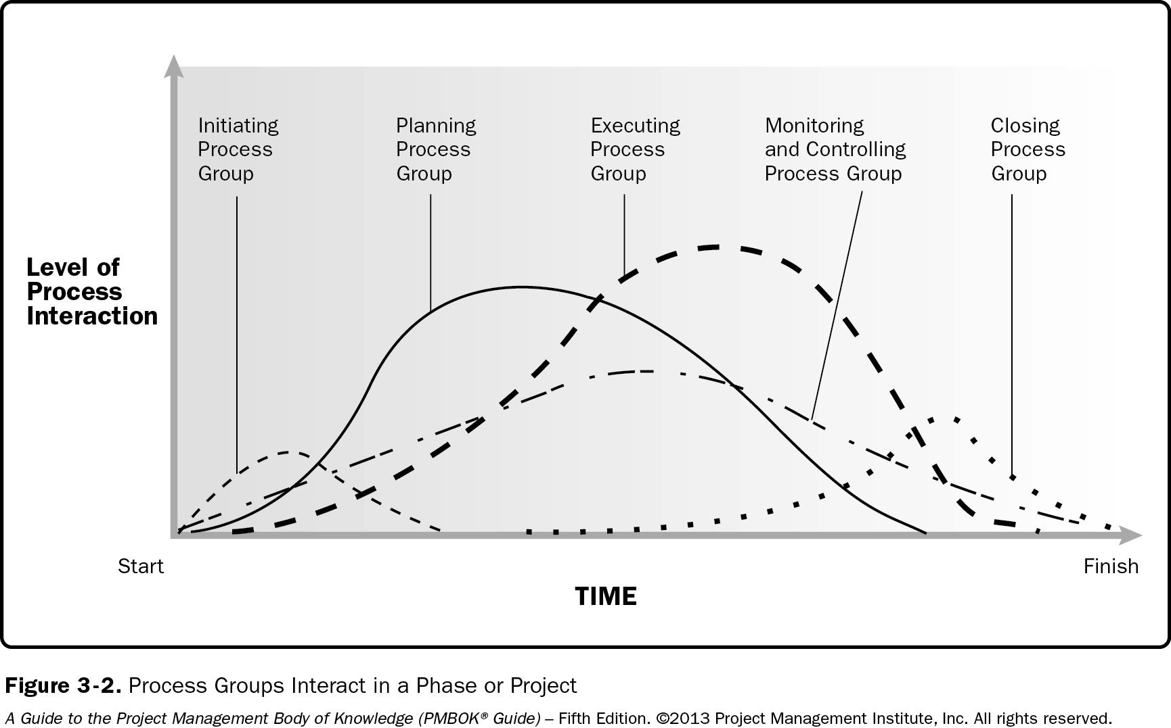
PMBOK and it’s Major Process-Groups

Slide 27

Short Exercise
List one SPECIFIC and one GENERIC SFIA Skill that you Like. Write a sentence to explain why you like it. Repeat the same for one that you may not like:
_______________________________________
_______________________________________
_______________________________________
_______________________________________

Slide 28
Sub-Module Introduction to Agile
As a Project Management Approach
© MethodScience; Material drawn from The Art of Agile Practice (B. Unhelkar)

Slide 29
Agile can be considered as an umbrella term representing a suite of software development methodologies (or processes, as they are occasionally called).
These software development methodologies are lightweight in terms of their rigor, less focused on planning, relatively thin on documentation and primarily reliant on people and their interactions.

Slide 30
What comprises Agile?
The Agile manifesto – which provides the fundamentals of agile methods
The Agile Values – that explain how the manifesto can be implemented through a culture and value system
The Agile Principles – that provide role-based guidance to in applying the agile manifesto and values in real projects
The Agile Practices – are execution of action that subscribe to the agile principles and are carried out by specific project roles

Slide 31

Figure 2.1: Relating Agility to Business Stability
Stability
Agility
Business Architecture
Governance
Process Maturity
Pro-active Customer Management;
Compliance with Regulations
Business
Business Intelligence
Rapid Decision Support
Creativity
Innovation
Collaborations
Lean
IT Systems Migration
Formal SDLC
Requirements Modeling
Process Maturity (CMM)
Quality Processes ISO9001
Enterprise Architecture
SOA; Legacy Environment
Rapid Development, Testing & Deployment
Agile Manifesto;
Principles; Values; Practices ;
(Trust, Collaboration)
Software

Slide 32

Key Points (Summary)
Project Management requires careful planning including:
Scope; Time; Budget;
The popular Software Development Life Cycles (SDLCs) are:
Waterfall
Spiral
Iterative and Incremental
The Iterative and Incremental Life cycle leads to Agility
Agile Methods are relevant to Organizations – beyond Software Development

Slide 33

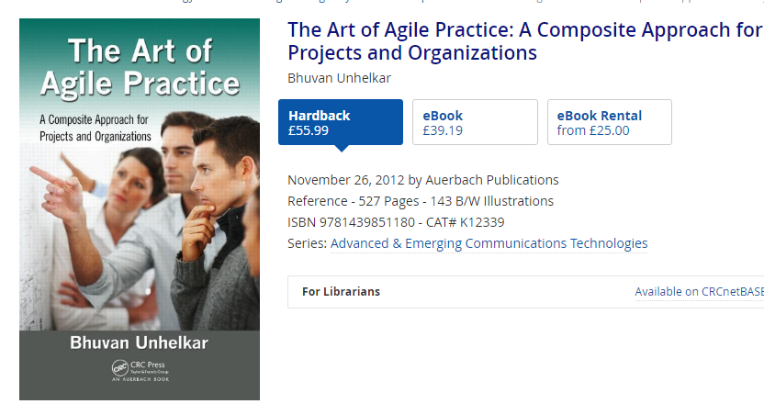

References
Textbook
The Art of Agile Practice, (2012), CRC Press, USA.

Slide 34

Discussion, Q & A, Workshop
Would you agree for a need to BALANCE the planned, formal SDLCs with Agility? Discuss with Examples from your Experiences / Readings;
Argue FOR the need to form Project Teams with well defined roles in order to Learn and Practice Project Management

Slide 36
Sub-Module Project Team Formation
Cross-Functional; Co-Located;
© MethodScience; Material drawn from The Art of Agile Practice (B. Unhelkar)

Slide 37
Introductions…
Name and Preferred Name
Your Background (Program, Courses completed etc.)
Career aspirations etc.
Something personal and unique
You cannot introduce the person who introduces you; hence please rotate the introductions around your team

Slide 38

Team-Ace
A

Slide 39
Team-Big
A

Slide 40
Team-Cap
A

Slide 41
Team-Don
A

Slide 42
Team-Eat
A

Slide 43
Team-Fun
A

Slide 44
Team-Gem
A

Slide 45
Team-Hat
A

Slide 46
Conclusions & Future Directions
We discussed…??
Do you see what we see?

Slide 48
Short Exercise –
Q 1: NPS stands for:
New Productivity System
Net Performance Score
New Promoter Score
Net Promoter Score
Q 2: Following is the best example of an MIS that you would use in managing the raw materials being supplied to a Auto manufacturer:
CRM
SCM
DSS
GIS

Slide 49
Short Exercise – Compare ANY two of the Systems discussed from any ONE Role’s viewpoint: Role = ______
Type of MIS =
Type of MIS =
(a)
(b)
(c)

Slide 50
Short Exercise –
Type
[A]
[B]
[C]
[D]
Type
[A]
[B]
[C]
[D]

Slide 51
Short Exercise –
Type
[A]
[B]
[C]
[D]
Type
[A]
[B]
[C]
[D]

Slide 52

Project Work (Group-based Case Analysis, Report & Presentation)
By now you will have…
In this week you will be…
Created Report and PPT shells with your details
Fully understood and listed all the DATA needs of your case study
Remember: This DATA documentation and modeling is an iterative activity (so there will be updates as we proceed)
You will have included the various types of data and their EXAMPLES
Listing the key objectives of your MIS project
Modified your problem statement to reflect your thinking and assumptions
Created at least THREE outlines/descriptions of MIS relevant to your case study: ERP, CRM and SCM
Undertaken a short comparison (Table)

Slide 53
References
As discussed in the lecture

Slide 54
Short Exercise-
How will you incorporate a community of ‘expectant mothers’ in the HR module of your MIS for a large Telecommunications company? _________________________________________________________________________________________________________________________________
What are the advantages and risks for forming e-Communities outside of your given Organization? ______________________________________________________________________________________

Slide 55
Week-1 Introduction to Project Management; Introduction to Agile; Agile Manifesto; SDLCs; Team Formation & Collaboration ISM 6930 – 3 Credit Hours Special Topics (Agile Project Management - APM) Spring, 2018; Room: A205 (12:00pm to 2:45pm) Dr. Bhuvan UNHELKAR IT Faculty, College Of Business; Office: C225; bunhelkar@sar.usf.edu; 941-359-4654

